Slide 1
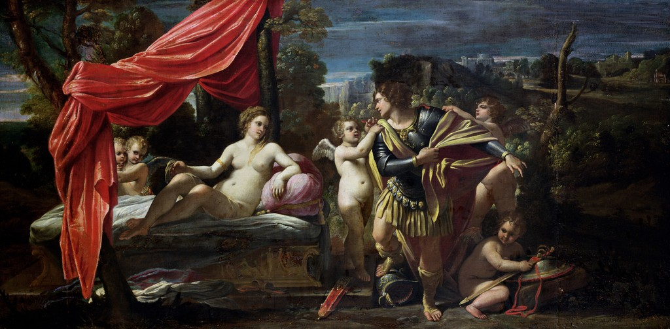
Venus and Mars are lovers So why Weed Warriors? An Eco-Astrological exploration
Mars and Venus 1620 - Sisto Badalocchio
Zheljana Peric
The Centre for Studies in Religion and Theology
Monash University.

Slide 2
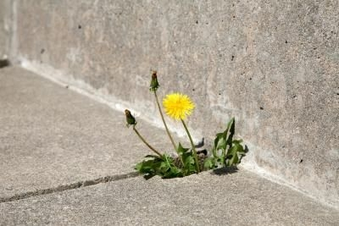
outline
What is astrology?
Weeds in context
Conventional weed control as an astrological
Mars warrior archetype
Venus as redemptive power of Love – ‘befriending weeds’
Venus and Mars unite in new ways of thinking
Questions

Slide 3
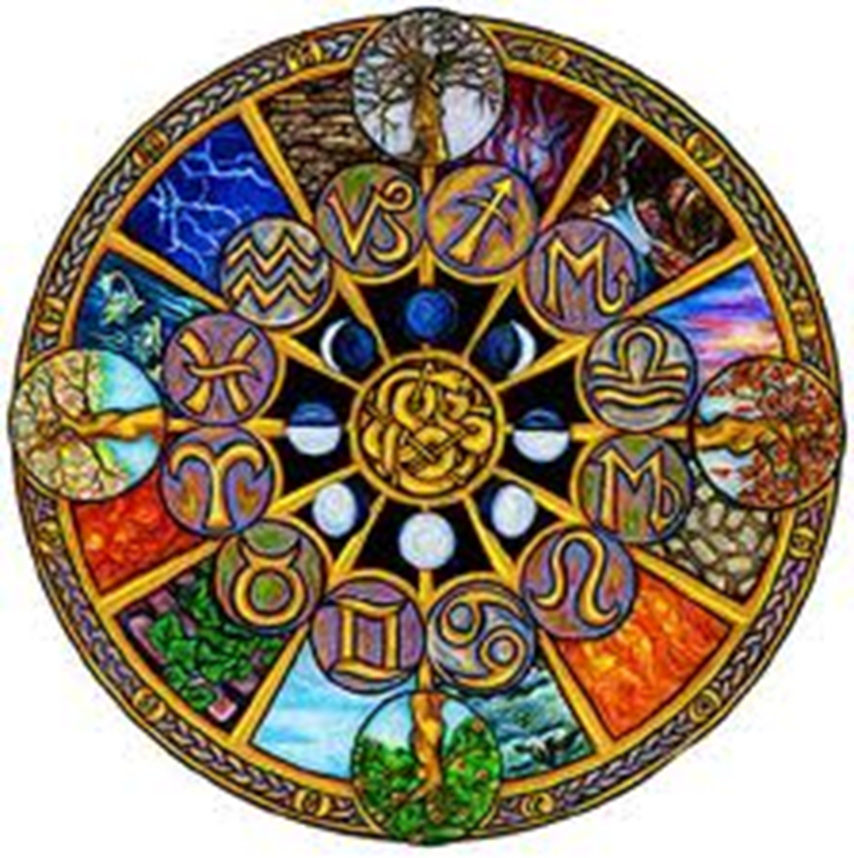
What is Astrology
Winter
Astrology – study of time & cycles as represented celestially & what this means to life on earth.
Spring
Autumn
An important function of the zodiac wheel was as a calendar intended to measure time for agricultural activities, & religious & sacred festivities.
Summer

Slide 4
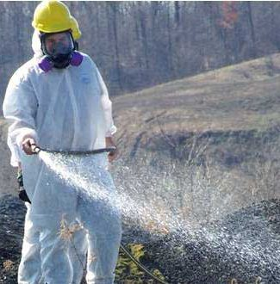
Weeds in context
Australia spends over A$1.3 billion dollars annually on wholesale herbicides
(Australian Pesticides and Veterinary Medicine Authority, 2010-2011).
Language surrounding
weed issues is often
highly emotionally
charged.
‘Weed Warriors’
‘Danger’
‘A War on Weeds’
‘Toxic’
‘Weed Killer’

Slide 5
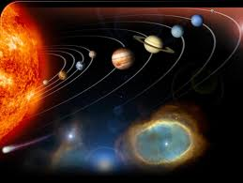
Astrological Archetypes
Astrological archetypes are alive in everything – anything we can think, see, dream, image or experience is animated with the energies of a particular god or goddess as embodied in the planets of our solar system.
Mars the Warrior Archetype as personified in the planet
Mars
Venus the Goddess of Love as personified in the planet
Venus.

Slide 6
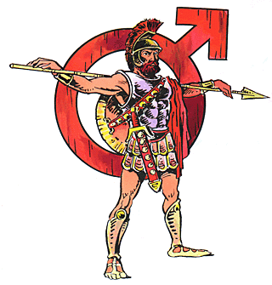
Mars the Archetype of War
Astrologically the planet Mars is embodied in the psyche of both men and women as the masculine/yang principle of:
War, Battles & Fighting
Killing & Bloodshed
Power Over & Danger
Our ability to act & take
action, defend or attack
The energy, force & drive
needed do act & work
‘Mars is our ability to turn a plant into an enemy’

Slide 7
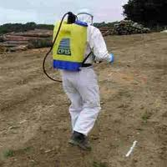
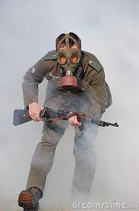
Mars as Warrior in images of a War on Weeds
Who is the Enemy?

Slide 8

The war also rages on the home front

Slide 9
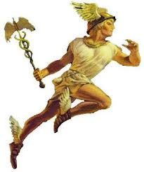
The power of words and images
Words and images (archetypes) are loaded and have consequences
James Hillman
What are some of the consequences of invoking Mars the god of war?

Slide 10
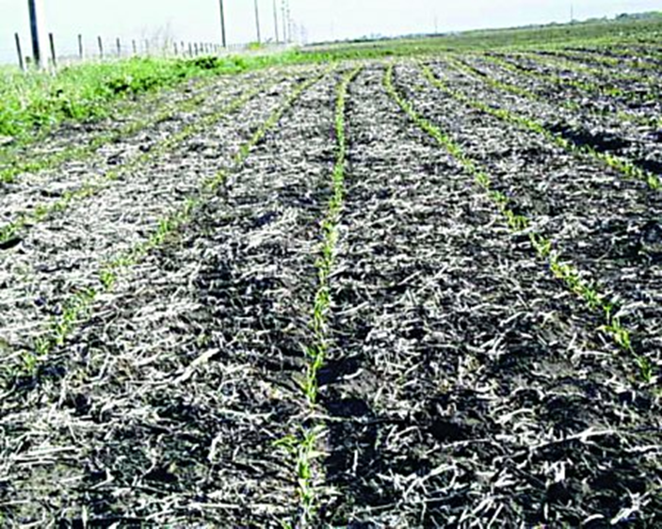
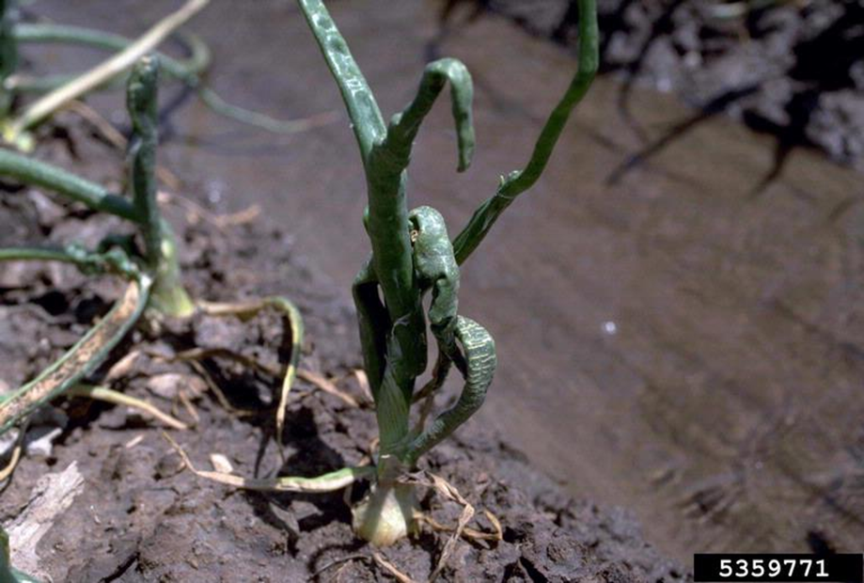
Consequences of the Warrior Archetype
Damage from exposure to 2,4-D herbicide (originally an ingredient of agent orange) in a corn field
Deformity in onion crops
John Kennicker, Iowa State University Extension
Center for Invasive Species and Ecosystem Health
University of Georgia

Slide 11
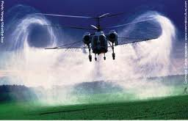
Herbicide Spray Drift
Roundup herbicide linked to Parkinson’s-related brain damage
Anne Sewell, Digital Journal

Slide 12
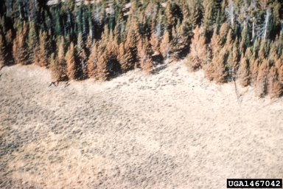
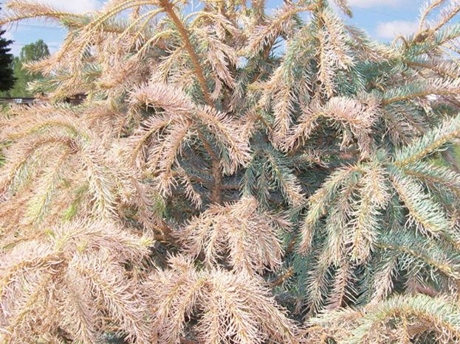
Herbicide Damage to Trees
Drift from sagebrush spraying 2,4-D
Herbicide damage caused by
2,4-D
Forestry Images - Center for Invasive Species and Ecosystem Health, College of Agricultural and Environmental Sciences
Utah State University

Slide 13

Herbicides damage fish & Waterways
‘…agrochemical pesticides and herbicides in the waters of two rivers in Costa Rica … is suspected to be behind massive slaughters of aquatic life.’
Jaime Lopez Costa Rica

Slide 14
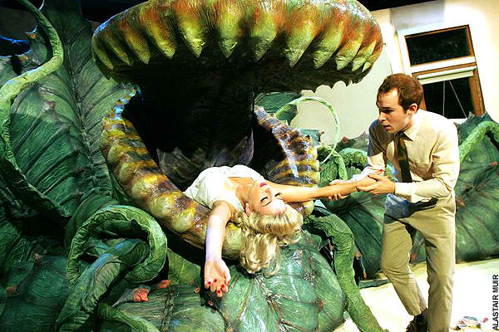
weeds fight back Herbicidal resistance
Cactus Thorns, 2012

Slide 15

Stop the War on Weeds

Slide 16
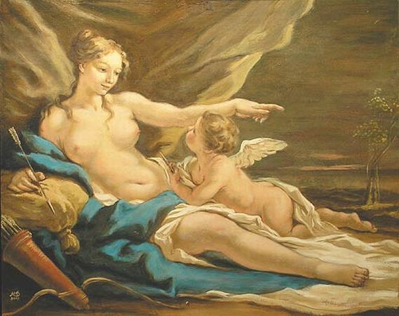
Venus the archetype of Love
Astrologically the planet Venus is embodied in both men and women as the Feminine/Yin principle of:
Love Union & Attraction
Understanding, Peace & Harmony
Planets, flowers, the earth
‘Gardens – as s a metaphor of living
&loving
‘The redemptive power of Beauty’
Aphrodite and Eros by Giovanni Antonio Pellegrini (1675 - 1741)
Venus is our ability to ‘turn a weed’ into a beneficial herb.

Slide 17
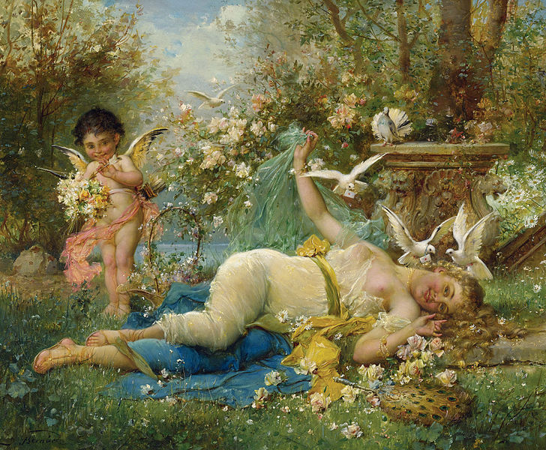
Possible consequences
Venus and Cupid. Signed J Bernard, 1933

Slide 18
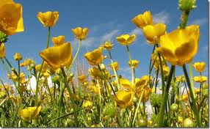
Understanding Weeds
What is the purpose of weeds?
Weeds can tell your about soil chemistry.
Buttercups, dandelions and onion grass thrive in acidic soil.

Slide 19
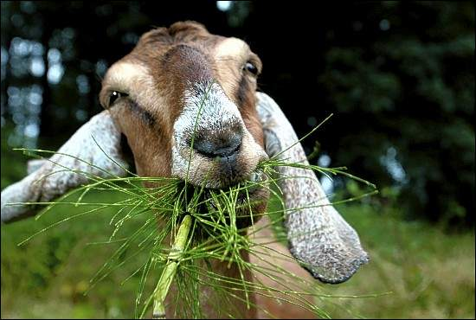
Weeds as resource
Animal fodder - Goats love weeds
A better way to spend A$1.3 billion
Source: weedsnetwork.com

Slide 20
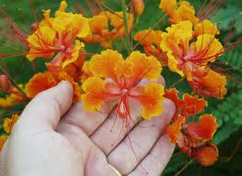
Reconciliation- Befriending Weeds
Venus embodies what is of value
Do the weeds we want to kill have any value?
Value gives meaning and purpose to life
Source: www.psychcentral.com

Slide 21
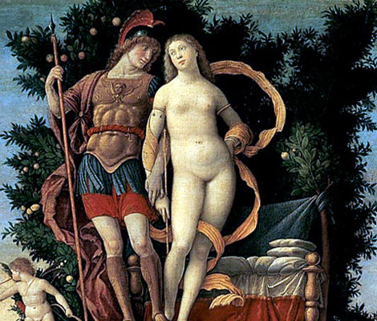
Mars and Venus are Lovers
Astrologically and mythologically Mars and Venus are lovers.
‘The ideal expression of Mars and Venus comes when they are balanced by each other… the result is the splendid dance of creation.’
Howell, 1987:159
Mars and Venus Painting of 1497 by Andrea Mantegna (1431–1506)

Slide 22
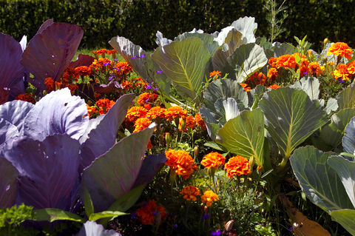
Beautiful & Constructive
Weeds have substances in their roots, flowers, and leaves that can either repel or attract insects.

Slide 23
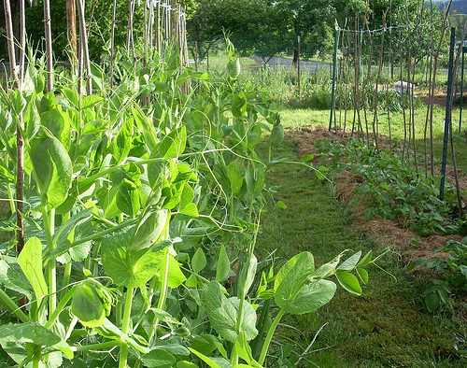
Beneficial Weeds
Polyculture imitates the diversity of natural ecosystems.
It includes intercropping, companion planting and beneficial weeds – such as clover which fertilises soil.

Slide 24
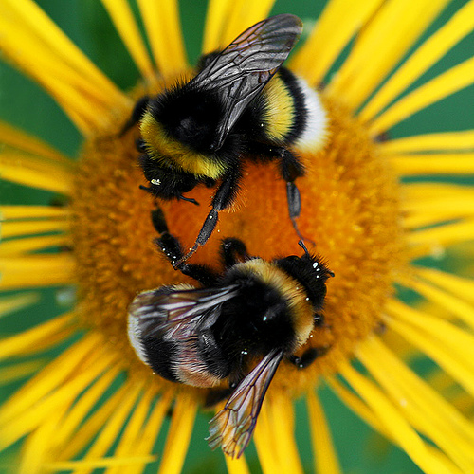
Conclusion
‘…you love the earth and the earth loves you. And therefore the earth brings forth. That is so even with the peasant who wants to make his field fertile, and in the night of the full moon he sleeps with his wife in the furrow.’
Jung in Bennet (2006:159)

Slide 25

questions
Thank you

